Slide 1


DIABETES DETECTION PROJECT
Diabetes stands as a global health crisis, frequently leading to severe complications such as heart disease and blindness. The current diagnostic process is often slow and cumbersome, requiring multiple visits and prolonged waiting periods for results. This project leverages data mining techniques to predict the probability of diabetes, aiming to streamline diagnosis and facilitate early intervention.
Notes:
1

Slide 2

The Challenge: Timely Diagnosis
Traditional Diagnosis
Long Wait Times
Serious Health Risks
Reports often take a day or more, delaying critical information.
Delays can exacerbate health issues like heart attacks and vision loss.
Patients must visit diagnostic centers for tests.
Notes:
2

Slide 3












Methodology: CRISP-DM Framework
Our project rigorously followed the Cross Industry Standard Process for Data Mining (CRISP-DM) framework, ensuring a structured and comprehensive approach to diabetes detection.
Business Understanding
Data Understanding
Defining project objectives and problem assessment.
Collecting, assessing, and initial data analysis.
Deployment
Data Preparation
Planning and monitoring model implementation.
Cleaning, transforming, and selecting relevant data.
Evaluation
Modeling
Calculating model accuracy and success rates.
Selecting and applying appropriate data mining techniques.
Notes:
3

Slide 4
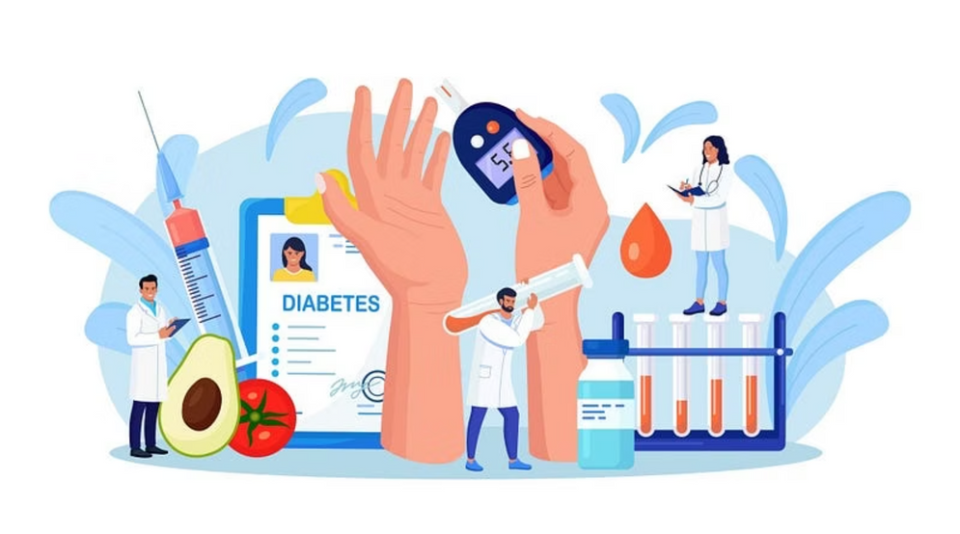
Data Understanding: Pima Indian Diabetes Dataset
Source & Objective
Dataset from the National Institute of Diabetes and Digestive and Kidney Diseases.
Credited to the UCI Machine Learning Database Repository. https://www.kaggle.com/datasets/uciml/pima-indians-diabetes-database
Goal: Predict diabetes based on diagnostic measurements.
Sample Characteristics
769 total samples.
All patients are females, at least 21 years of age.
Distribution: 500 non-diabetic, 269 diabetic individuals.
Notes:
4

Slide 5
Key Attributes for Diabetes Detection
The dataset comprises nine attributes: eight independent variables and one dependent class variable.
Class Variable
Binary outcome (0 = Non-Diabetic, 1 = Diabetic)
Dependent Variable (Target)
Glucose
Plasma Glucose Concentration (2-hour test)
≥ 200 mg/dL diagnoses diabetes
BMI
Body Mass Index
≥ 30 is within the obese range
Pregnancies
Number of times pregnant
Increased risk with higher count
Blood Pressure
Diastolic Blood Pressure (mmHg)
> 90 mmHg indicates high B.P.
Insulin
2-Hour Serum Insulin (mu U/ml)
Values above 16-166 mIU/L range are alarming
Skin Thickness
Triceps Skin Fold Thickness (mm)
Higher thickness correlates with increased diabetes chances
Diabetes Pedigree Function
Diabetes history in relatives
Higher function increases patient likelihood of diabetes
Age
Age in years
Risk generally increases with age
Notes:
5

Slide 6


Data Preparation: Cleaning & Transformation
Thorough data preparation was crucial for model accuracy, involving cleaning of anomalies and strategic data transformation.
Data Cleaning
Data Transformation
Handling Zero/Null Values: Zeroes in Glucose, BMI, Blood Pressure, Insulin, and Skin Thickness were treated as nulls and imputed with the mean of their respective columns.
Feature Selection: All eight independent variables were retained due to their collective impact on diabetes prediction.
Categorization (Binning): Continuous variables like Glucose and BMI were binned into discrete ranges based on established medical standards for better model interpretability.
Outlier Detection & Removal: Outliers, predominantly in Insulin and Skin Thickness, were identified and removed using the Inter Quartile Range (IQR) method.
Data Splitting: The cleaned dataset of 498 records was split into a 60% training set (298 records) and a 40% testing set (200 records).
Notes:
6

Slide 7







Modeling: Algorithm Selection & Setup
We selected two prominent machine learning algorithms, CART and KNN, for their suitability in classification tasks with categorized independent variables.
Decision Tree
K-Nearest Neighbor (KNN)
Comparison Goal
Applied with a controlled depth of 4 to prevent overfitting and enhance interpretability.
Utilized for its non-parametric approach to classification based on feature similarity.
To identify the algorithm providing superior overall accuracy and precision for diabetes detection.
All models were developed using Python, leveraging the powerful Scikit-learn library, built upon NumPy, SciPy, and Pandas.
Notes:
7

Slide 8
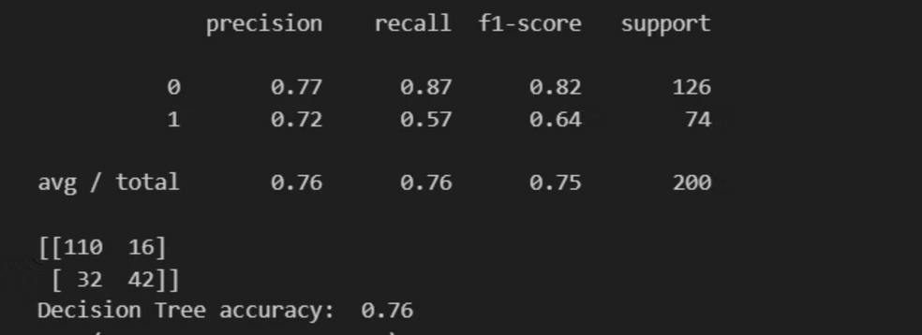
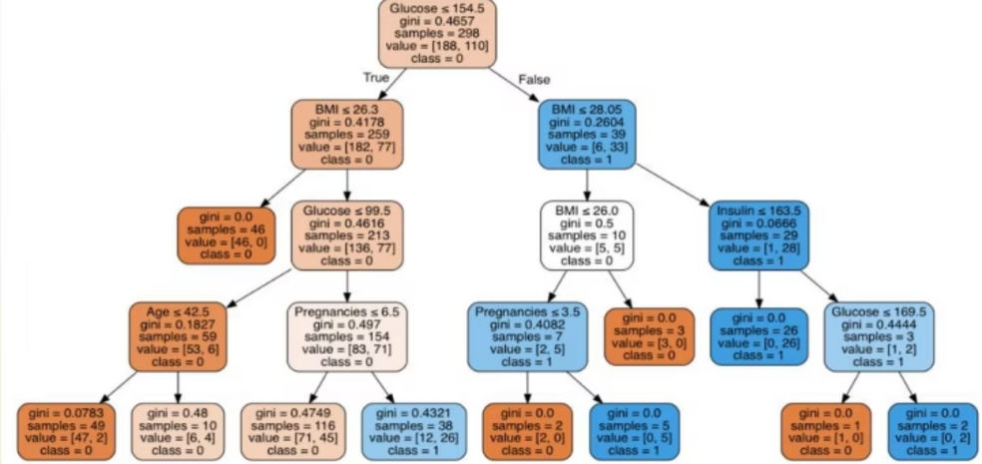
Evaluation: Performance Metrics
The evaluation highlighted the Decision Tree model's superior performance across key metrics.
The Decision Tree Model demonstrated consistently better overall results, particularly in accuracy and AUC, confirming its robustness for this classification task.
Notes:
8

Slide 9
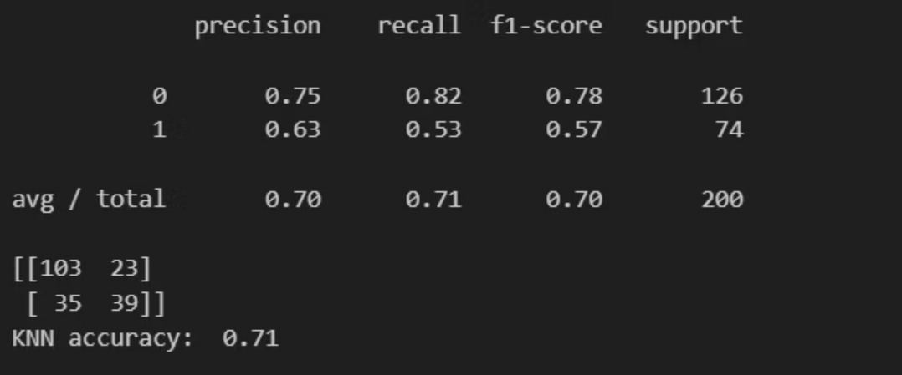
K-Nearest Neighbor (KNN) Comparison
The K-Nearest Neighbor model was used as an alternative model for comparison. The results confirmed that the Decision Tree was the better choice.
Overall Accuracy: The KNN model achieved an accuracy of 71%
Area Under the ROC Curve (AUC): The AUC was 0.67 (Lower than the Decision Tree's 0.72
Confusion Matrix (Diabetic Class Focus):
True Positives (TP): 39
False Negatives (FN): 35
Recall (Class 1 - Diabetic): 0.53 (This value is lower than the Decision Tree's 0.57 making KNN less effective in detecting actual diabetic cases)
Final Conclusion: By comparing the results, the Decision Tree Model demonstrated better overall performance in comparison to the K-Nearest Neighbor Model.
Notes:
9

Slide 10
Feature Importance & Interpretation
The Decision Tree model provided crucial insights into which features were most influential in determining diabetes probability.
1
Insulin (0.010)
2
Age (0.036)
3
Pregnancies (0.134)
4
BMI (0.260)
5
Glucose (0.558)
Features like Diabetes Pedigree Function, Skin Thickness, and Blood Pressure were found to have a negligible effect (0.000) in this model's determination of diabetes.
Notes:
10

Slide 11

Conclusion & Deployment Plan
The Diabetes Detection Project successfully developed a Decision Tree model with 76% accuracy, achieving the desired predictive capability through meticulous data processing.
Project Advantage
The derived rules from the model can empower medical professionals to identify at-risk patients early, enabling timely intervention and preventing severe complications.
1
Plan Deployment
Integrate the model into medical organizations for efficient and early diabetes detection.
2
Monitor Deployment
Implement continuous monitoring to ensure model performance and promptly detect any anomalies or errors.
3
Generate Reports
Regularly produce statistical reports summarizing the model's ongoing performance and impact.
Notes:
11

